Slide 1
UNSW-NB15 Network-Intrusion-Detection
資管三 潘躍升

Slide 2
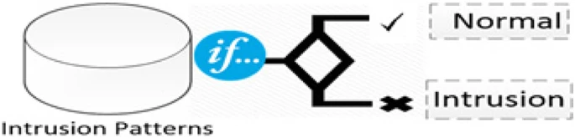
Motivation
Using UNSW-NB15 to classify Normal and Attack types.
Using machine learning to find patterns.

Slide 3
Data Source: UNSW-NB15
Created by Australian Centre for Cyber Security (ACCS).
A hybrid of real modern normal activities and synthetic contemporary attack behaviours.
49 features with the class label.
Two million and 540,044 records.
Training set is 175,341 records and testing set is 82,332 records.

Slide 4
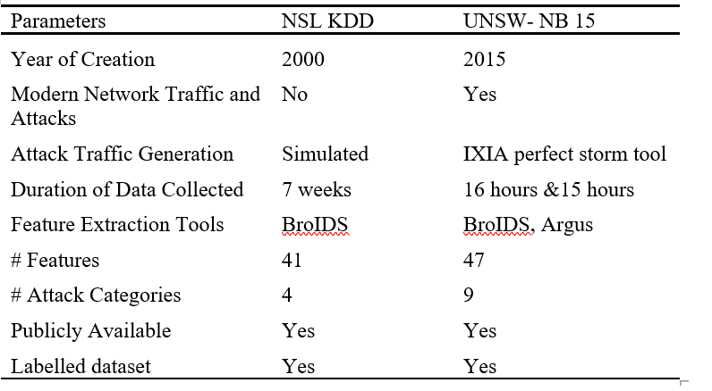
Data Source: UNSW-NB15

Slide 5
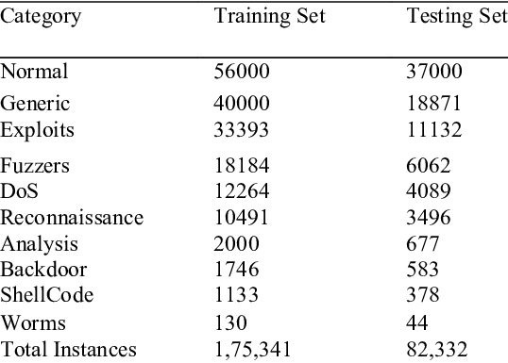
Attack Type
Nine types of attacks:

Slide 6
Features
Flow Features | Base Features | Content Features
Time Features | Additional Generated Features | Labelled Features

Slide 7
EDA
Convert categorical variable (proto, service, state) into dummy/indicator variables.
Add Unique features to another dataset.
Encode categorical feature (attack_cat) as a one-hot numeric.
Combine training and testing set together and random sampling.
Try PCA, StandardScaler for better performance.

Slide 8
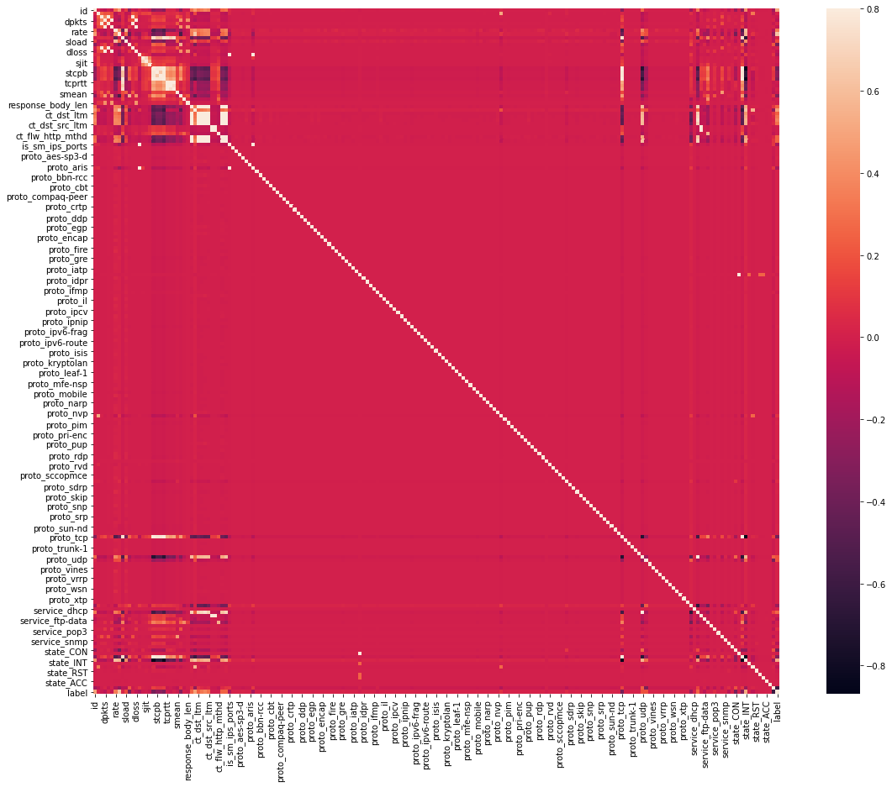
EDA - Correlation Matrix

Slide 9
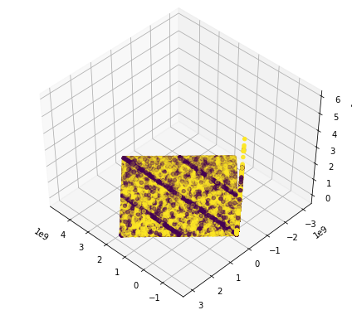
EDA - PCA (Original)

Slide 10
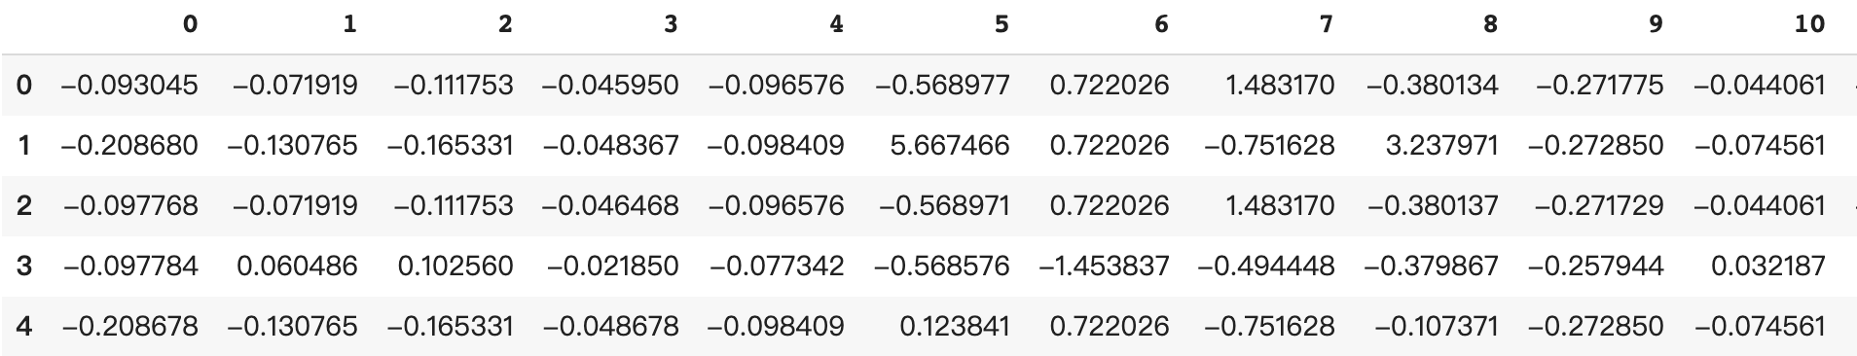
EDA - Standard Scaler

Slide 11
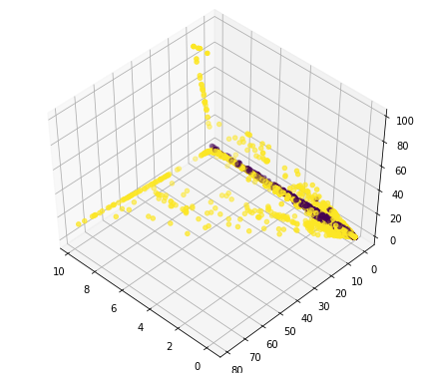
EDA - PCA (StandardScaler)

Slide 12
Model
Binary Class
Binary Class
Logistic Regression
Naive Bayes
Decision Tree
Random Forest
AdaBoost
Neural Network
Logistic Regression
Naive Bayes
Decision Tree

Slide 13
Classify Binary Classes
Model | Logistic Regression | Naive Bayes | Decision Tree | Random Forest | AdaBoost | Neural Network
Accuracy | 0.81 | 0.77 | 0.94 | 0.95 | 0.92 | 0.72
Precision | 0.81 | 0.76 | 0.93 | 0.94 | 0.92 | 0.77
Recall | 0.95 | 0.84 | 0.94 | 0.95 | 0.93 | 0.63
F1 Score | 0.86 | 0.82 | 0.95 | 0.96 | 0.94 | 0.74

Slide 14
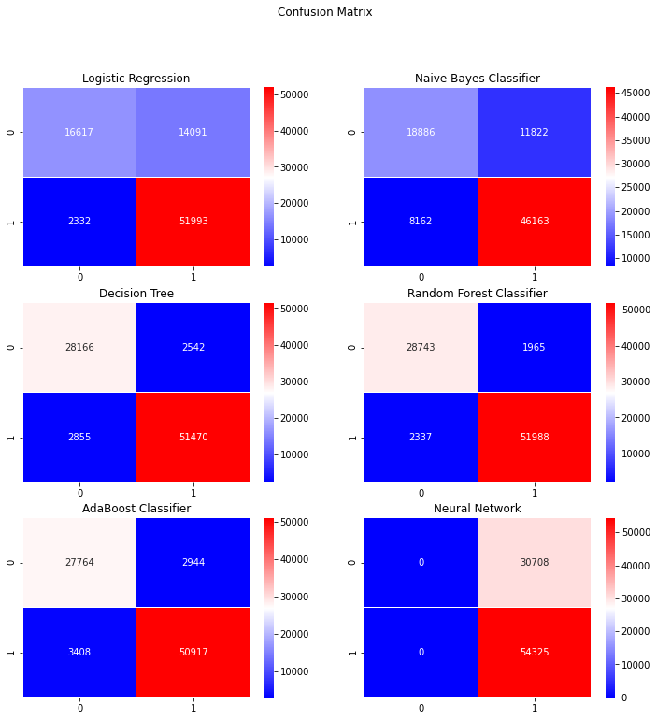
Classify Binary Classes

Slide 15
Classify Multi Classes
Model | KNN | Decision Tree | AdaBoost
Accuracy | 0.66 | 0.80 | 0.62
Precision | 0.66 | 0.80 | 0.65
Recall | 0.66 | 0.80 | 0.62
F1 Score | 0.65 | 0.80 | 0.62

Slide 16
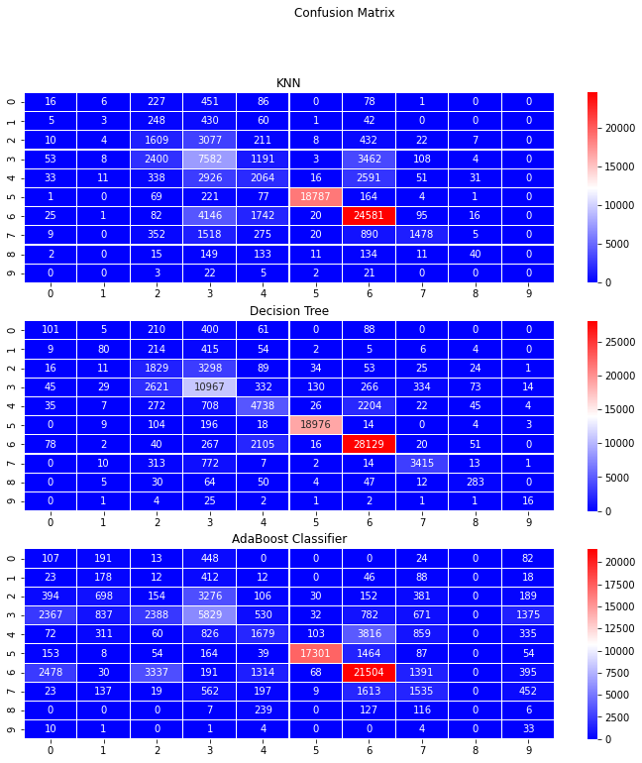
Classify Multi Classes

Slide 17
Refernce
Moustafa, Nour & Slay, Jill. (2016). The evaluation of Network Anomaly Detection Systems: Statistical analysis of the UNSW-NB15 data set and the comparison with the KDD99 data set. 1-14. 10.1080/19393555.2015.1125974.

Slide 18
The End

